Slide 1
Army Research Lab Web Interface
Design Day Presentation
Team 313 04/04/2024
Notes:
Yosuf

Slide 2
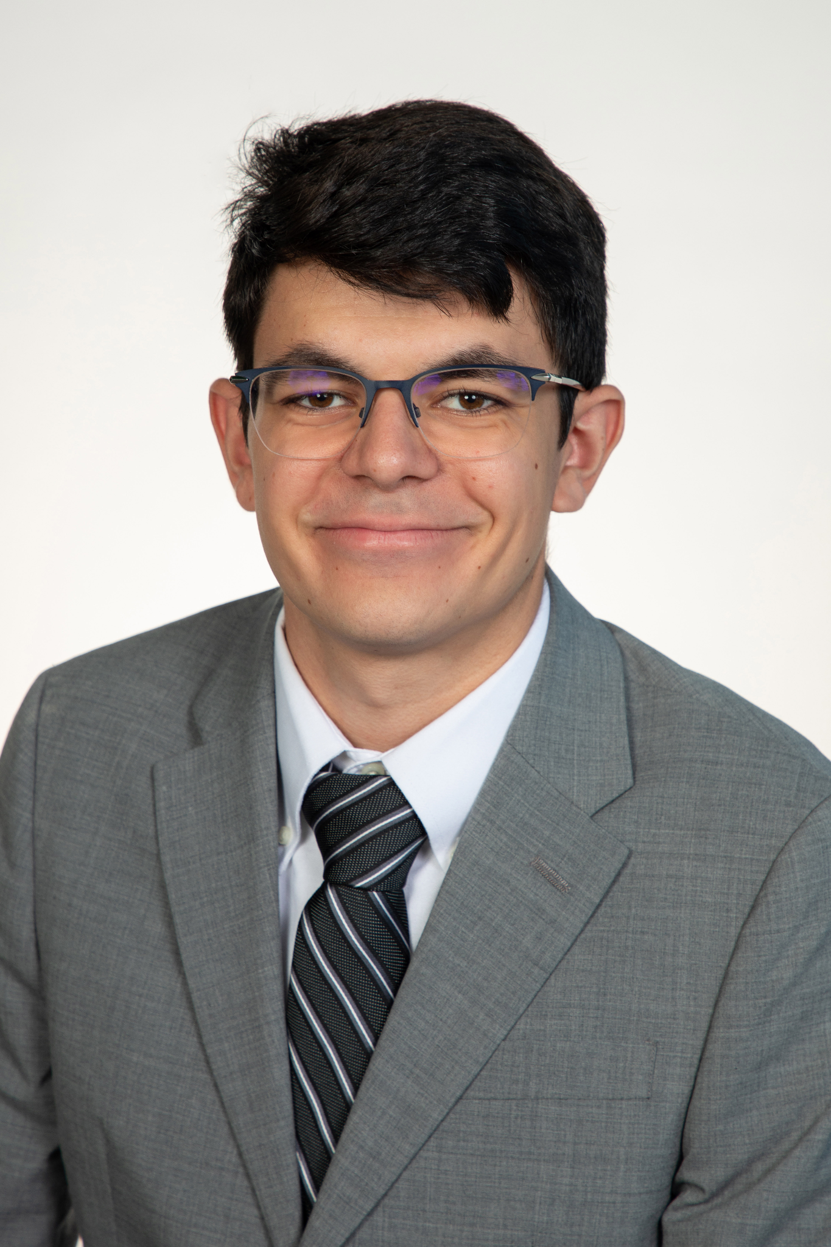
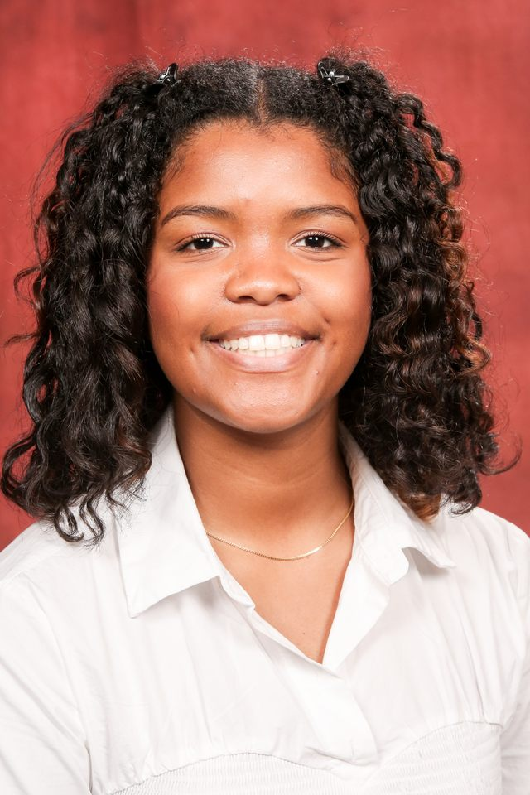
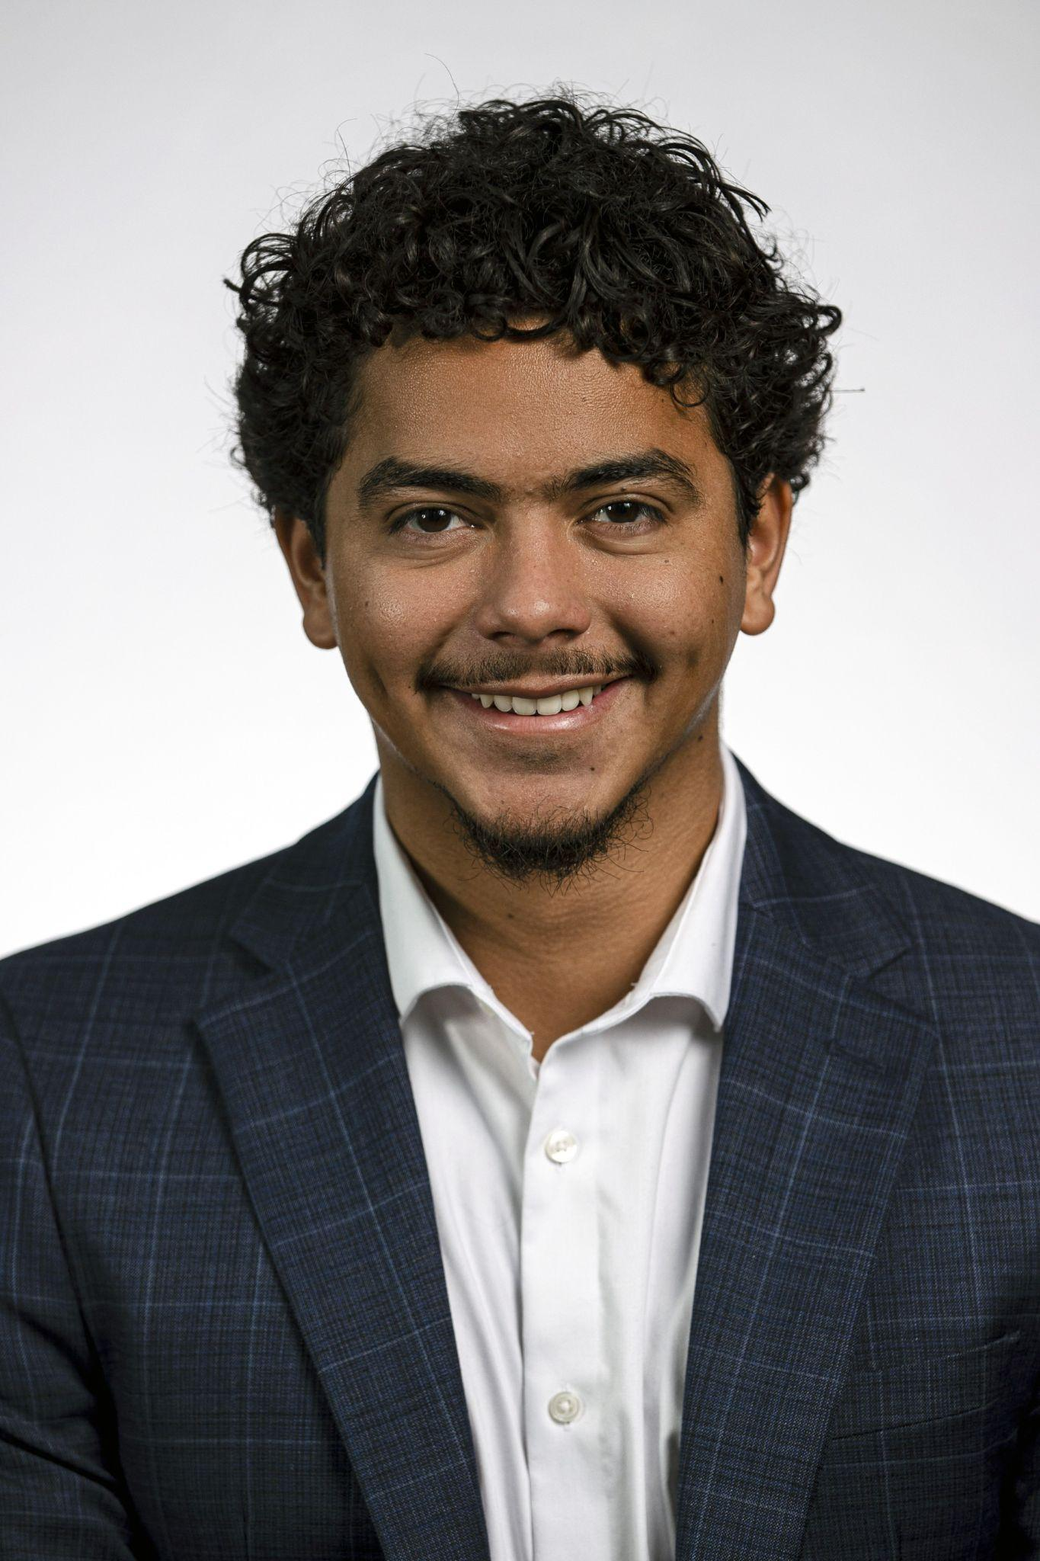
Team Introductions
Yosuf Young
Team Leader
Computer Engineer
Andrew Poirier
Lead Computer
Engineer
Anaice Soares-Concepcion
Facilitator & Financial
Advisor
Jose Hernandez
Lead Electrical Engineer
Notes:
Yosuf

Slide 3
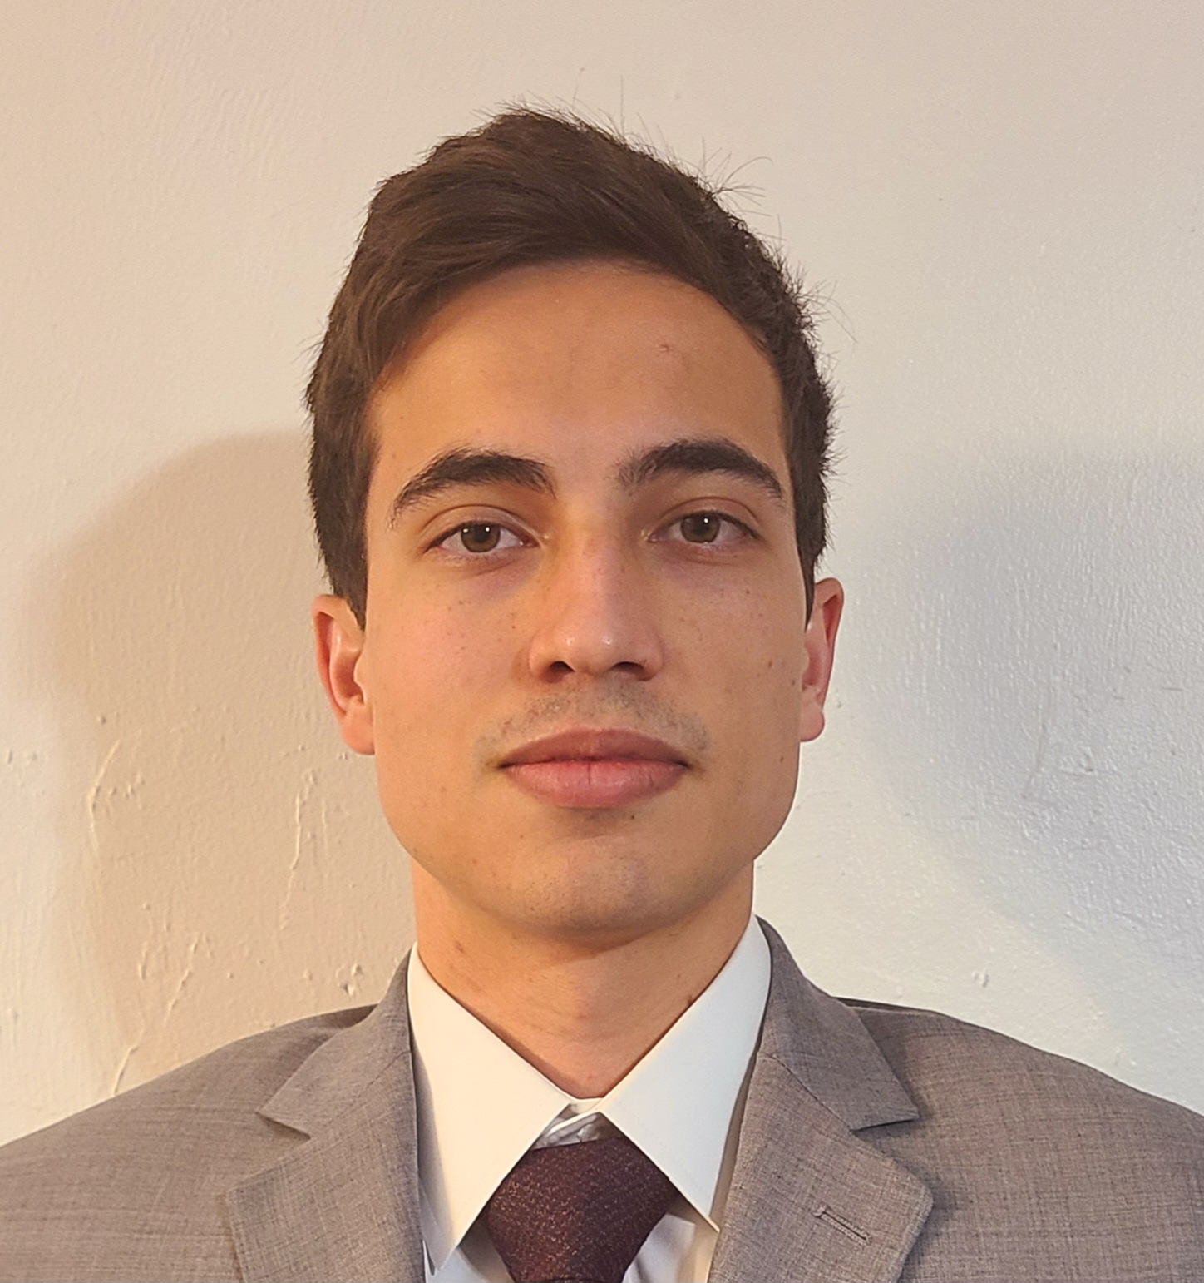
Team Introductions
Ashok Phatak
Electrical Engineering
Test Engineer
Francisco Malave
Computer Engineering
Test Engineer
Notes:
Yosuf

Slide 4
Sponsor and Advisors
Engineering Mentor
James Humann, Ph.D.
Academic Advisor
Jerris Hooker, Ph.D.
Notes:
Yosuf

Slide 5
Abstract
Problem- Other departments in DEVCOM struggle to access the basic functions of a Raspberry Pi-powered drone due to the lack of a proper interface.
Motivation- This initiative aims to alleviate the workload on the DEVCOM lab, while enhancing overall company productivity.
Results- Successfully created a user friendly interface that accomplishes the objectives.
Notes:
Yosuf

Slide 6
Project Objective
Team 313's objective is to design and develop a
user-friendly web-based interface with
multifaceted capabilities.
This interface aims to facilitate:
Seamless execution of commands
Configuration of files
Retrieval of logs and data
Bluetooth and Wifi toggling
Remotely toggle power
Notes:
Yosuf

Slide 7
Concept Generation, Concept Selection, & Budget
Presented by Anaice Soares-Concepcion
Notes:
Anaice

Slide 8
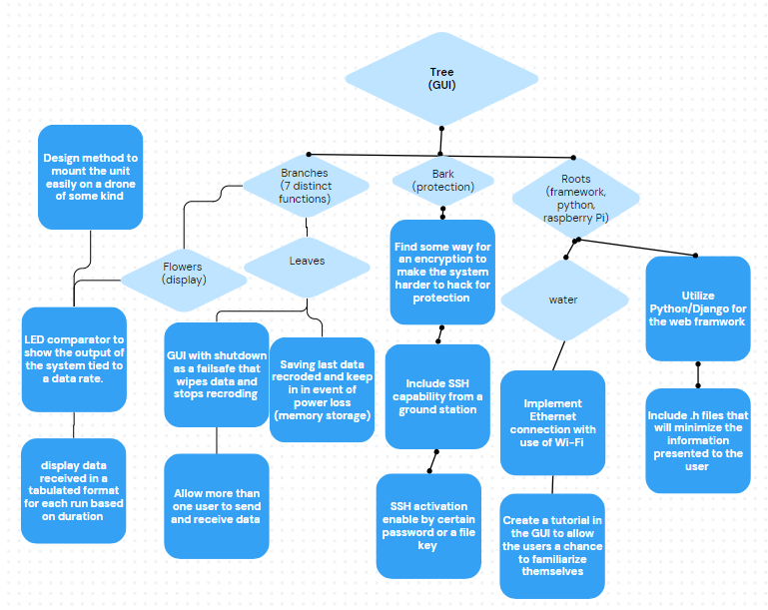
Concept Generation
The project scope provided by sponsor was extremely broad, involved multiple elements
Created a tree analogy to fully break down the project
Once broken down, we generated concepts for each individual element
Notes:
Anaice

Slide 9
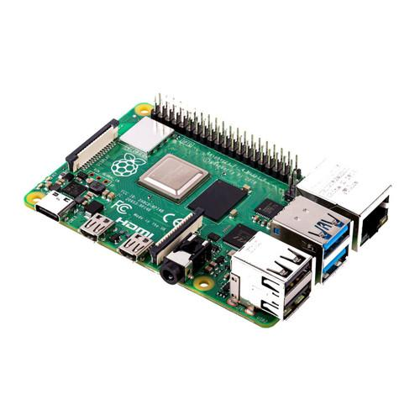
Concept Selection
We evaluated our top 3 generated concepts via multiple methods
House of Quality
Pugh Chart
AHP Chart
Also considered requirements provided by our sponsor
Final selected concept:
Utilize Python/Django for web framework
hosted on a Raspberry Pi 4, for ROS2 (Robot Operating System) drone system
Notes:
Anaice
The pre-existing system utilized Python Django
We chose the Raspberry pi 4 to host web server to be accessed remotely
Again, pre-existing ROS2 system

Slide 10
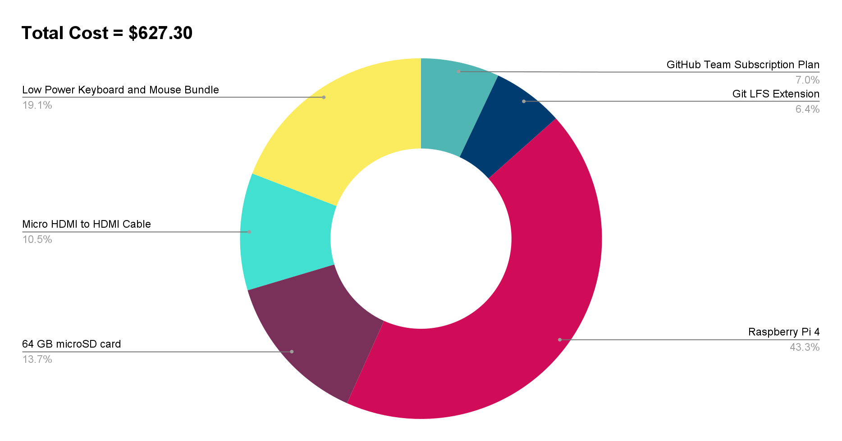
Budget
Notes:
Anaice

Slide 11
Current Design Review
Presented by Andrew Poirier, Jose Hernandez, Francisco Malave, and Ashok Phatak
Notes:
Ashok

Slide 12
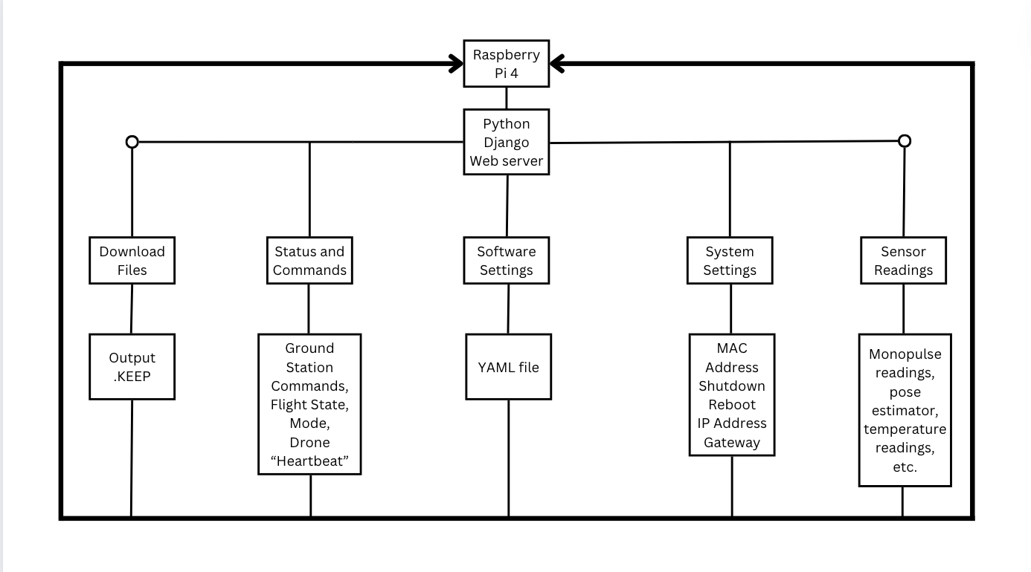
General Overview

Slide 13
Webpage Contents

Slide 14
Landing Page Design
Our current design format and functionality meet the minimal design requirements (helps reduce bandwidth as requested by our sponsor)
Notes:
Jose

Slide 15
System Settings Page Design
Controls certain aspects of the Raspberry Pi hardware
Displays MAC Address
Notes:
IP address label assigned to each device connected to a computer network. Two purposes: Identification ( house address) Routing. (source and destination).
Netmask: Divides IP into network and host portion.
Gateway: device that serves as an access point to other networks and facilitates communication between them.
Media Access Control address identifier assigned to network interface controller

Slide 16
Download Files Page Design
Download files page has also been completed
Comes with a drop down menu to select folder
Web page allows user to download output files (.KEEP extension) from several different folders within main output folder located on the Pi
Notes:
Jose

Slide 17
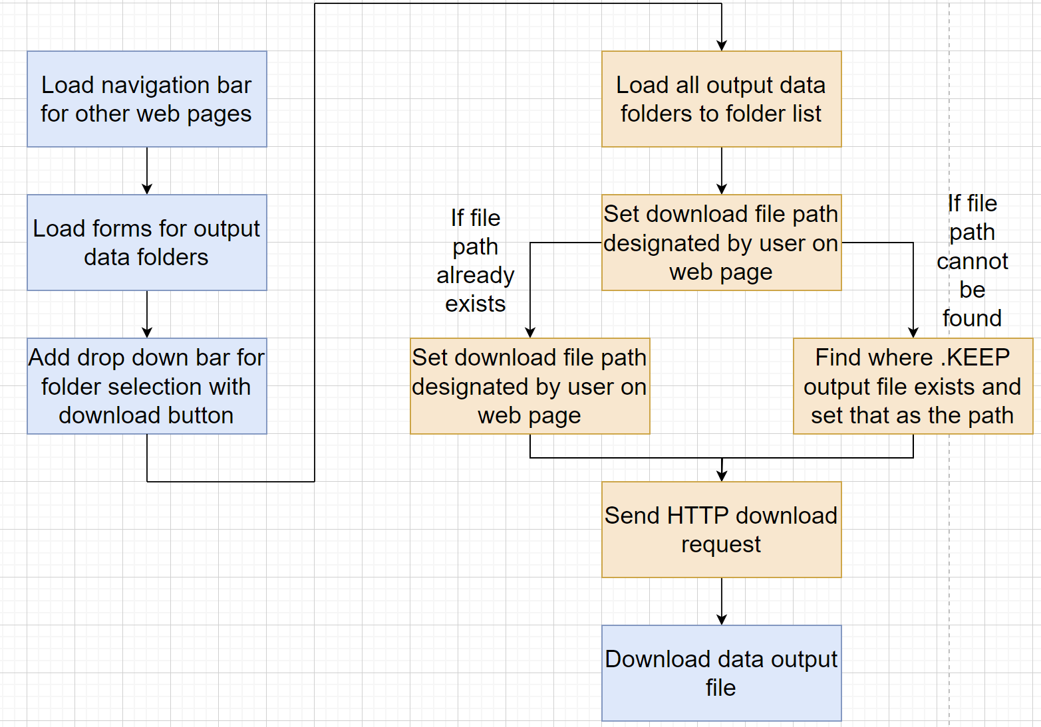
Download Files Pseudocode
* Note that boxes that are blue represent HTML operations and boxes that are orange represent python operations
Notes:
Note that blue is HTML and orange is Python

Slide 18
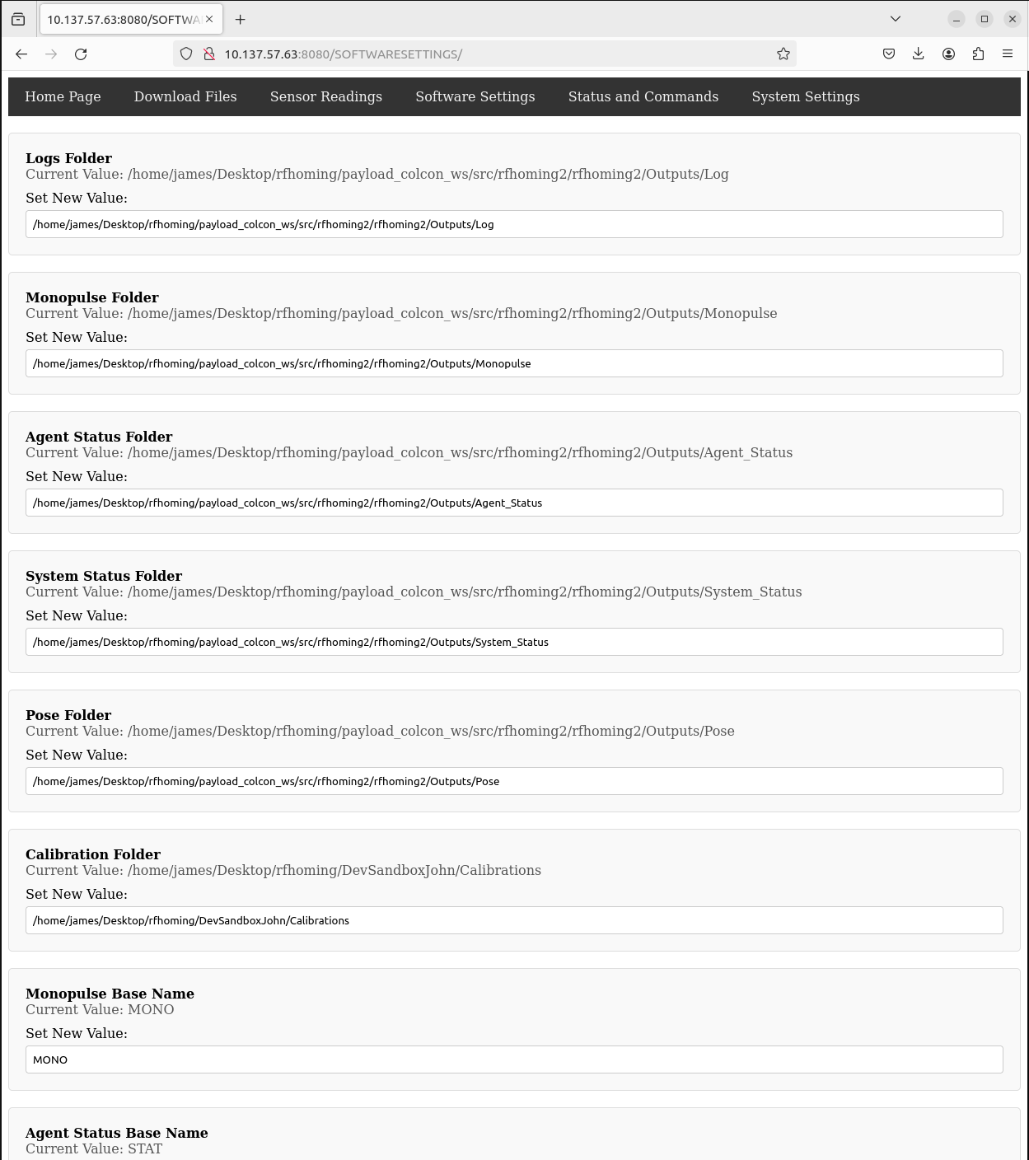
Software Settings Page Design
Web page allows the user to save software settings changes to the configure.yaml file
Complete with a ‘save changes’ button to allow user to write changes to the configure.yaml file
Fields include software settings data such as device ID, data output clock rate, etc.
Notes:
Andrew

Slide 19
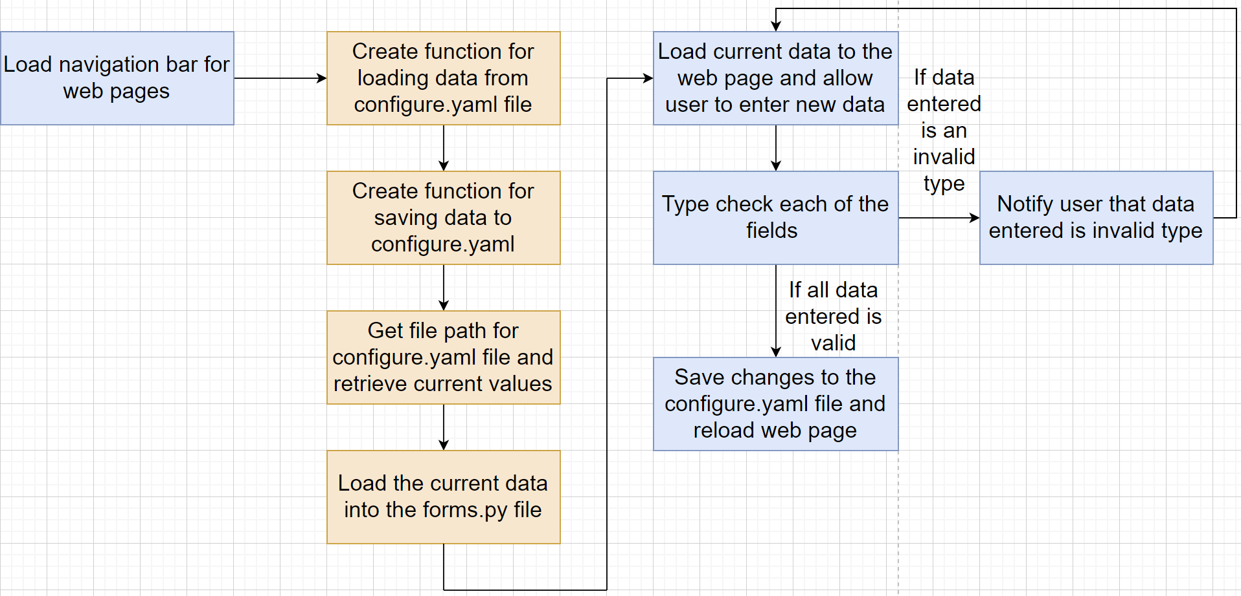
Software Settings Pseudocode
*Note that boxes that are blue represent HTML operations and boxes that are orange represent python operations
Notes:
Note that blue is HTML and orange is Python

Slide 20
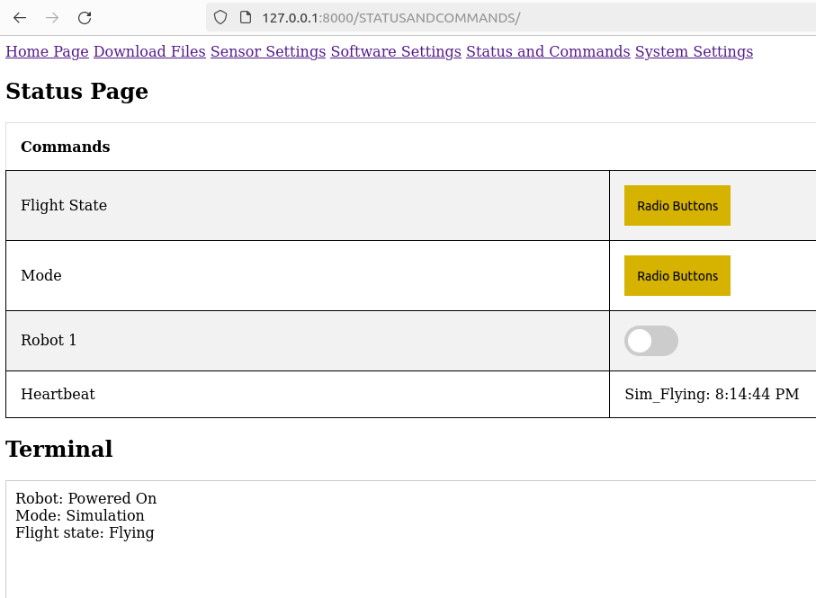
Status and Commands Page Design
The purpose of the status and commands page is to provide remote access to certain drone features
Flight state
Mode
Simulation vs. Real
State of robot
Heartbeat
Notes:
Andrew

Slide 21
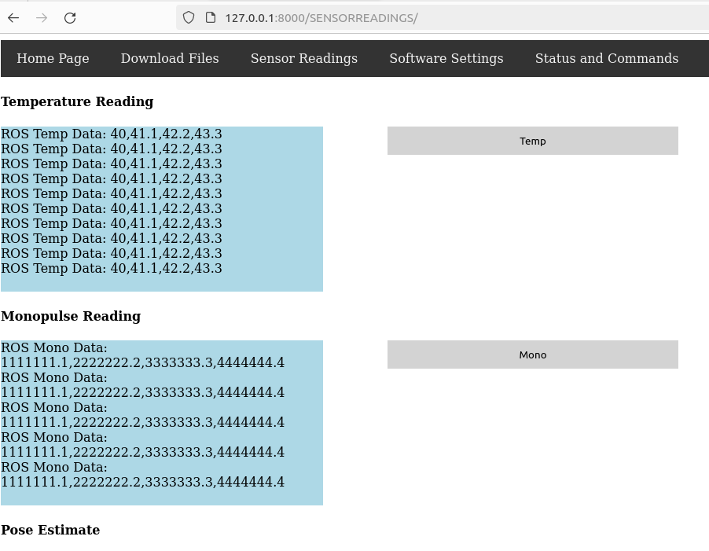
Sensor Readings Page Design
The sensor reading nodes have been successfully configured for retrieval and display within Django
Temperature reading
Monopulse reading
Workflow
Pose estimate
Notes:
Francisco

Slide 22
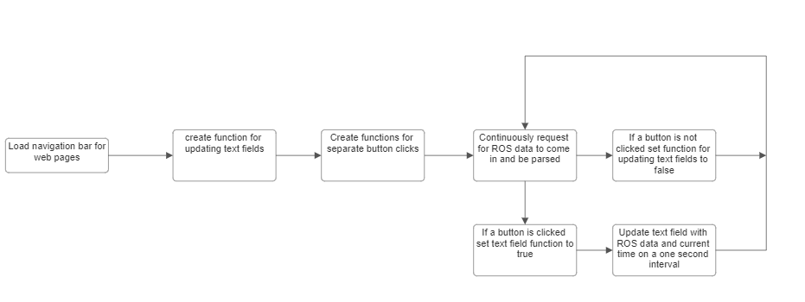
Sensor Readings Pseudocode

Slide 23
Final Design Functions
ROS2 instantiates prior to launch of Django program
ROS2, Roslibpy, IP config, handled via Django asynchronously
ROS2 has Roslibpy translations for:
Temperature_reading
Workflow
Pose_estimate
Ground_station commands,
Agent_status
Monopulse_reading
Notes:
Ashok

Slide 24
Final Design Functions cont.
Event handling
jQuery AJAX script for OS related ROS-2 operations
CSRF exemptions for development
Roslibpy library “translates” ROS-2 data to python
Notes:
Ashok

Slide 25
Current issues of the Design
Terminating Ros2 without a ‘pipe/thread’ implemented
Initial node connections sometimes yield an empty string or value
Notes:
Ashok

Slide 26
Testing and Validation
Presented by Francisco Malave
Notes:
Francisco

Slide 27
Procedure
Validate Initial Image File
Write and Modify Code
Send to our Sponsor
Trial and Error Testing
Validate with Dummy Values
Notes:
Francisco

Slide 28
Lessons Learned
Presented by Yosuf Young
Notes:
Jose

Slide 29
Lessons Learned
What we have learned:
How to create a user-friendly interface design with HTML and Java/CSS with Raspberry Pi
Asynchronous and real-time data handling
Integrating ROS2 with Django
Debugging python code
Developed strong communication skills
Better time management skills
Notes:
Jose

Slide 30
Questions?
Notes:
Jose

Slide 31
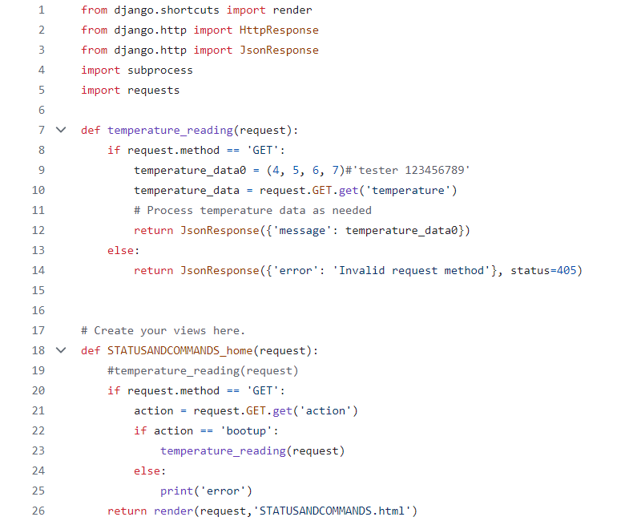
Status and commands views.py

Slide 32
Status and commands urls.py
This hoe also wrong

Slide 33
System Settings urls.py

Slide 34
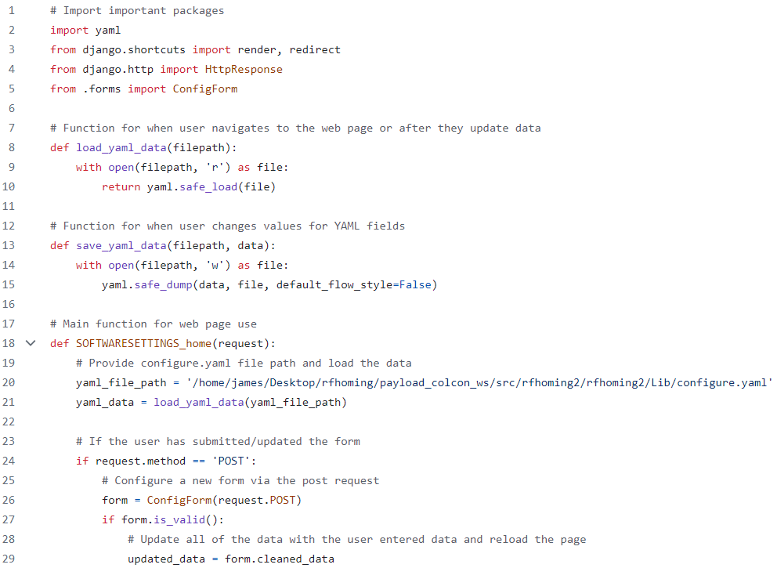
Software Settings views.py

Slide 35
Software Settings views.py

Slide 36
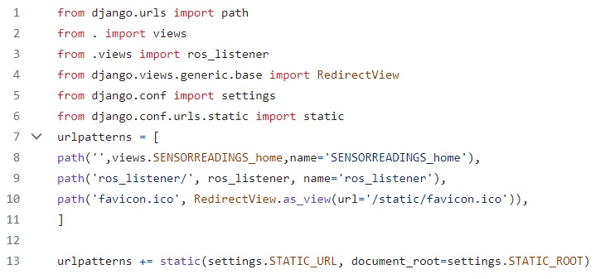
Sensor Readings urls.py

Slide 37
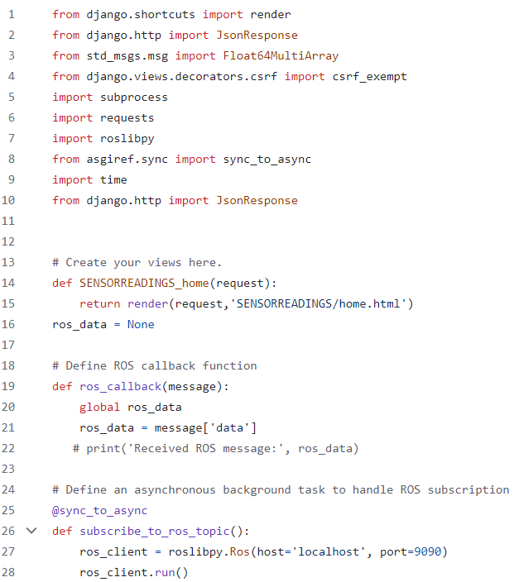
Sensor Readings views.py

Slide 38
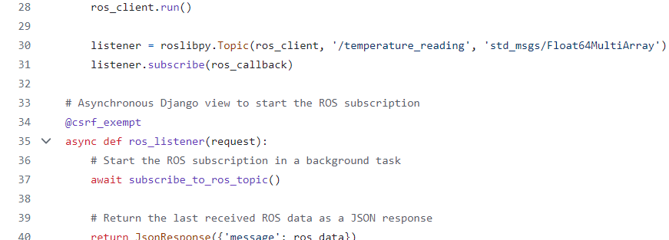
Sensor Readings views.py

Slide 39
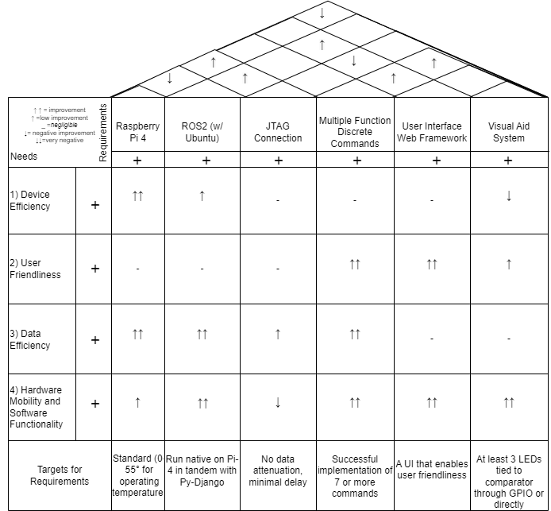
House of Quality
Notes:
Andrew

Slide 40
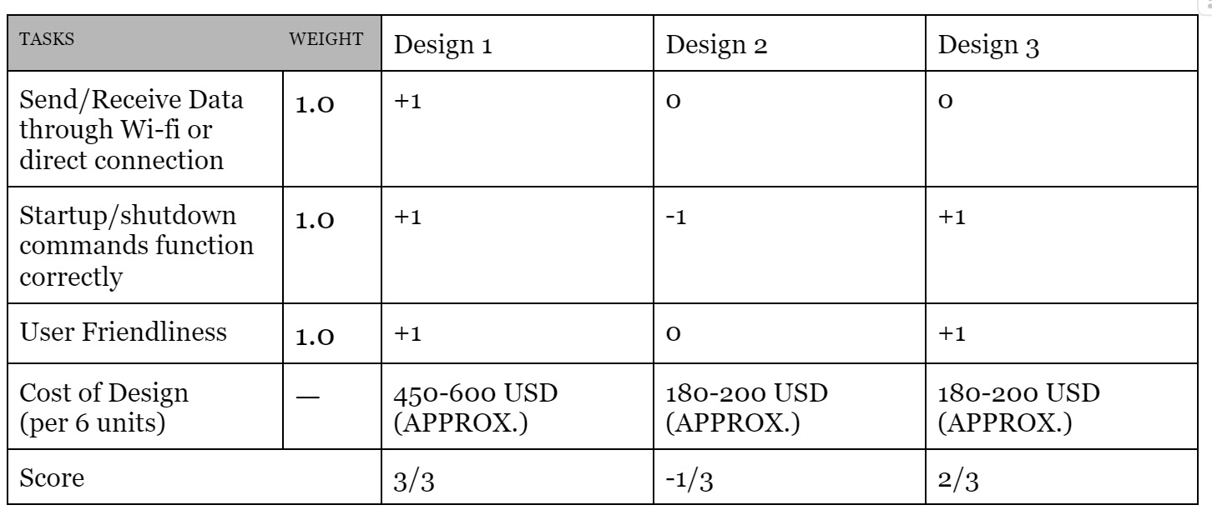
Pugh Chart
Design 1: Raspberry Pi-4 with Ubuntu (Operating System)
Design 2: MSP430 microcontroller design
Design 3: ARM Cortex M series based controller
Notes:
Andrew

Slide 41
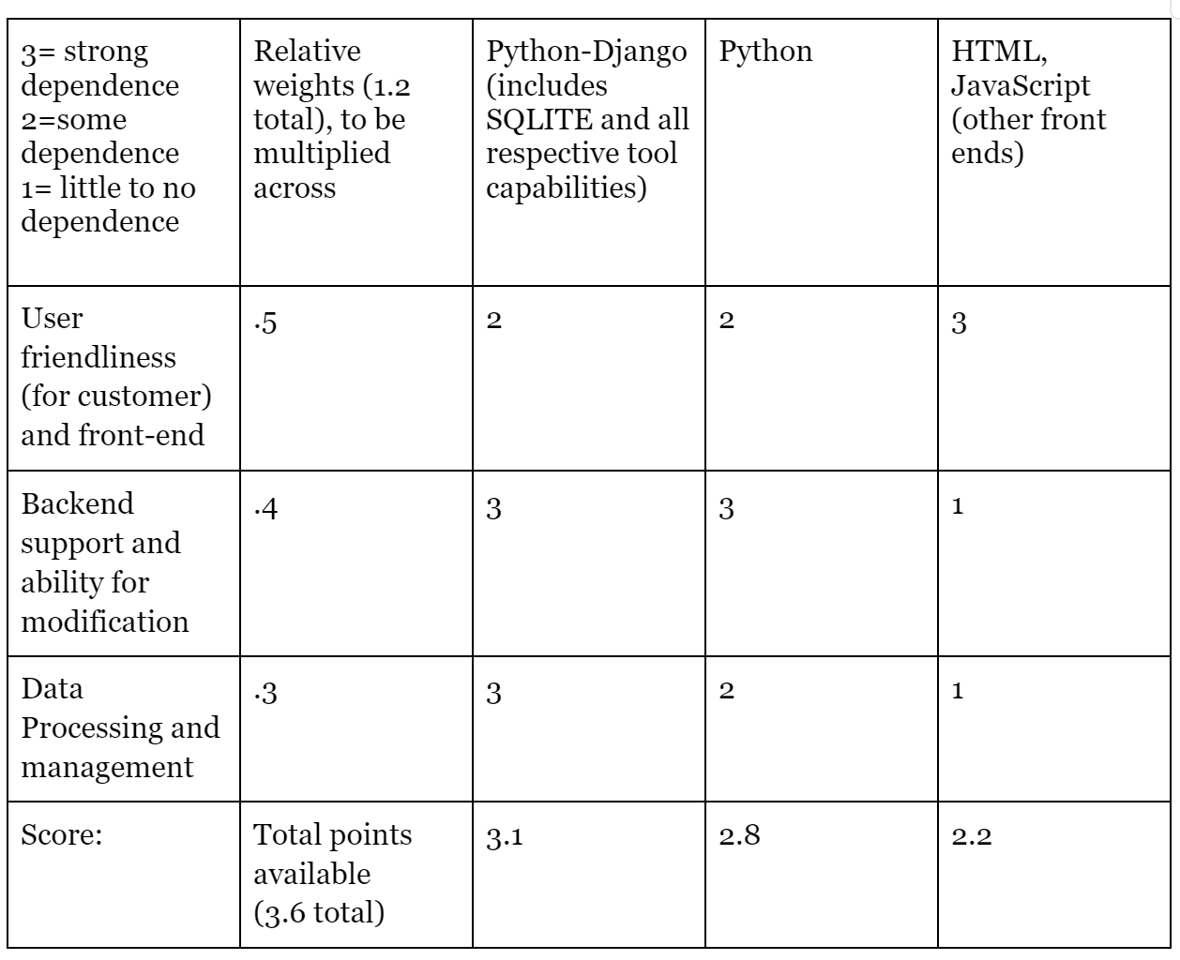
AHP
Notes:
Andrew

